Slide 1
2026 market planning
Campaign Performance Insights
By Vishwas Tilwani

Slide 2

Executive summary
Health & Education deliver the strongest ROI, making them priority sectors for 2026.
Fashion underperforms across profitability despite high conversion → cost-side inefficiencies.
Education has the lowest conversion rate, signaling a funnel optimization opportunity.
Fashion has the highest CPA, while Health & Education remain most cost-efficient.
Low-satisfaction campaigns show the highest ROAS, indicating expectation-setting and communication gaps.
Youths 18–24 & Professionals 35–50 are the strongest audiences, with high-quality conversions.
Parents 30–40 show high engagement but weak conversion, implying relevance or messaging issues.
All sectors overspend budgets by 2.5×–2.7×, exposing forecasting and pacing challenges.
Shift toward ongoing campaigns in 2024 suggests longer campaign cycles and changing workload patterns.
Analytical Criteria:
CTR = Clicks / Impressions (‘000 × 1000)
CVR = Conversions / Clicks
ROAS = Revenue / Ad Spend
CPA = Ad Spend / Conversions
Satisfaction Rating Classification: Low <2, Medium 2–4, High = 5
Campaign classification based on Completion Date i.e. Ongoing and Completed.

Slide 3
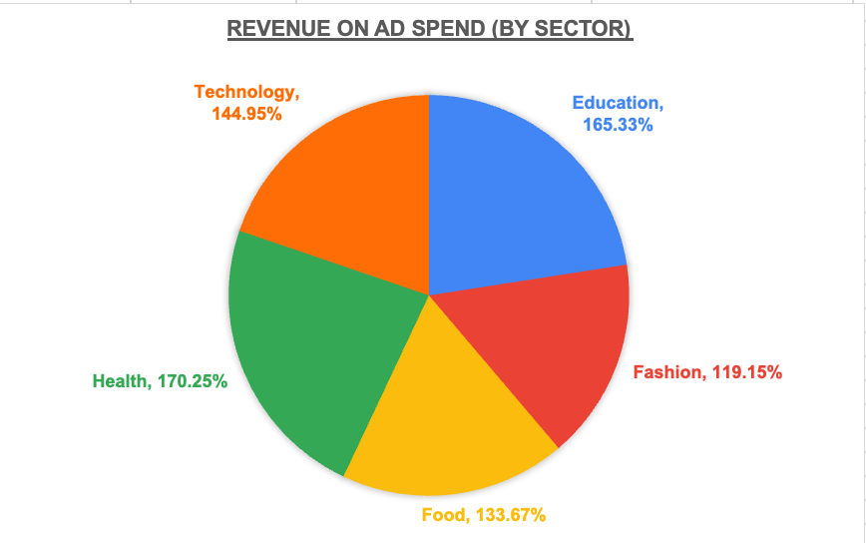
Return on ad spend (roas) by sector
Health & Education show the strongest ROAS (165–170%).
Fashion underperforms comparatively (119%).
Technology & Food deliver mid-range returns.
ROAS - Revenue / Ad Spend

Slide 4
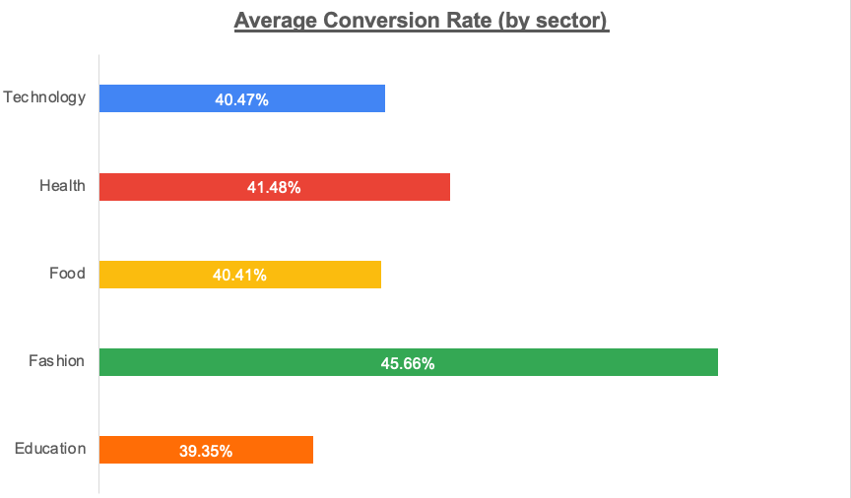
CONVERSTION RATE (cvr) BY SECTOR
Fashion has the highest conversion rate (~45.7%).
Health & Technology show strong, consistent conversion.
Education has the lowest CVR (~39.3%) → funnel inefficiency.
CVR = Conversions / Clicks

Slide 5
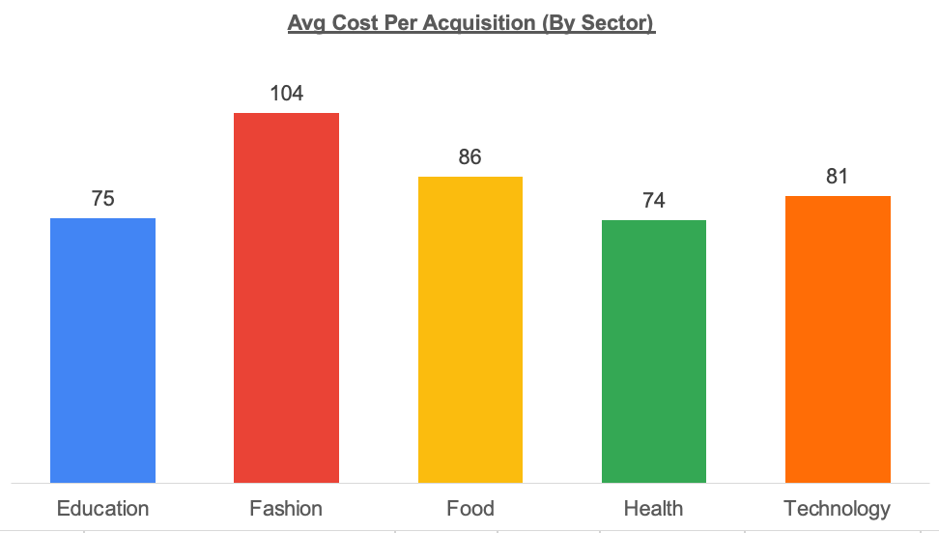
COST PER ACQUISITION (CPA) BY SECTOR
Fashion has the highest CPA (~$104) -> least cost-efficient.
Education and Health are most efficient (~$75).
Food and Technology is in the mid-range.
CPA = Ad Spend / Conversions

Slide 6
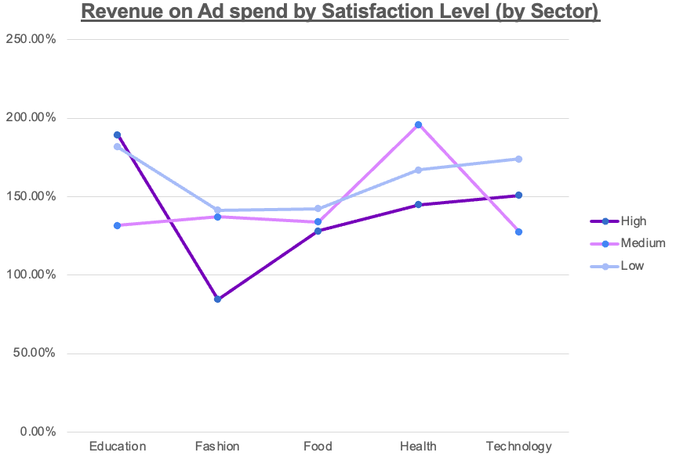
SATISFACTION RATING VS ROAS
Low-satisfaction campaigns show the highest ROAS.
High satisfaction ≠ highest performance (expectation gap).
Opportunity to improve communication & account management.
Satisfaction Rating Classification:
Low <2, Medium 2–4, High = 5

Slide 7
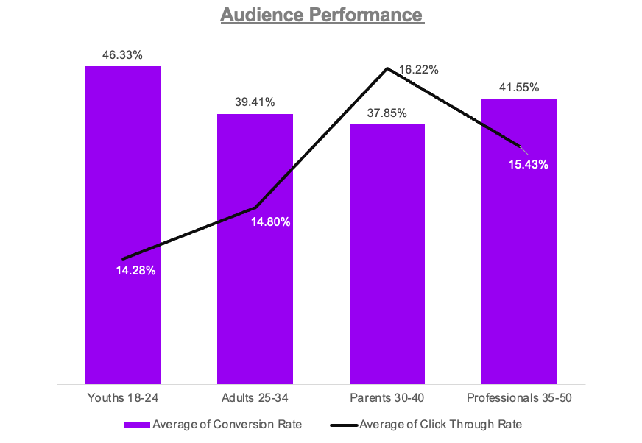
Audience performance
Youths 18–24 show the highest CVR (~46%).
Parents 30–40 have the lowest CVR (~38%).
Adults 25–34 & Parents overlap in performance.

Slide 8
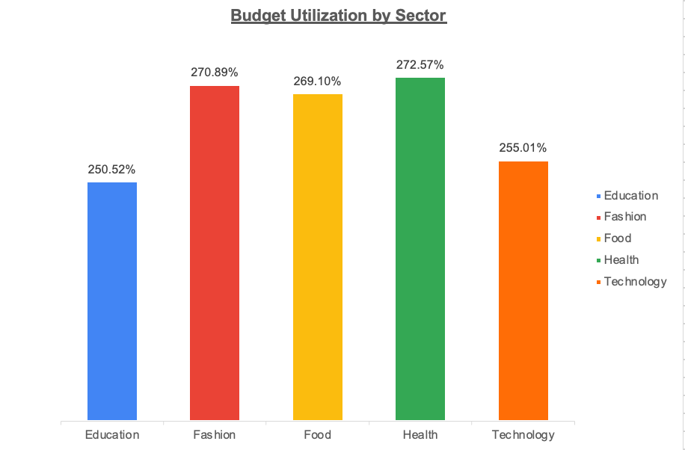
Budget utilization
All sectors exceed planned budgets by 2.5×–2.7×.
Indicates systemic forecasting and pacing issues.
Suggests reactive spending instead of planned execution.

Slide 9
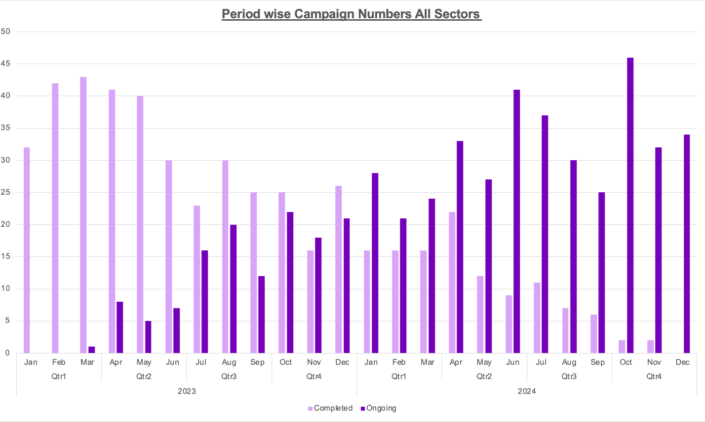
Period wise Campaign Numbers (All Sectors)
2023 shows more completed campaigns; 2024 shifts heavily to ongoing campaigns.
Clear seasonal peaks: early-year surges, mid-year slowdowns.
Indicates shift toward longer, continuously running campaigns.

Slide 10
Recommendations
Invest in high-performing sectors: Focus on Health & Education for scalable ROI.
Optimize weak-performing areas: Fix Fashion’s cost inefficiencies and improve Education’s conversion funnel.
Fix operational gaps: Address budget overspend, pacing issues, and client expectation alignment.
Refine targeting strategy: Priorities high-quality audiences, adjust messaging for Parents 30–40.
Support shifting campaign patterns: Plan resources for the increase in ongoing, long-running campaigns.
Dashboard (Extensive)

